Slide 1
DXC-REALTIME PROJECT
AZ-900,DP-203

Slide 2
NAME:BANDI PRAVEEN KUMAR
REG N0:DXC262ab1216
Project name:Smart Vehicles
Date:10-06-2022

Slide 3
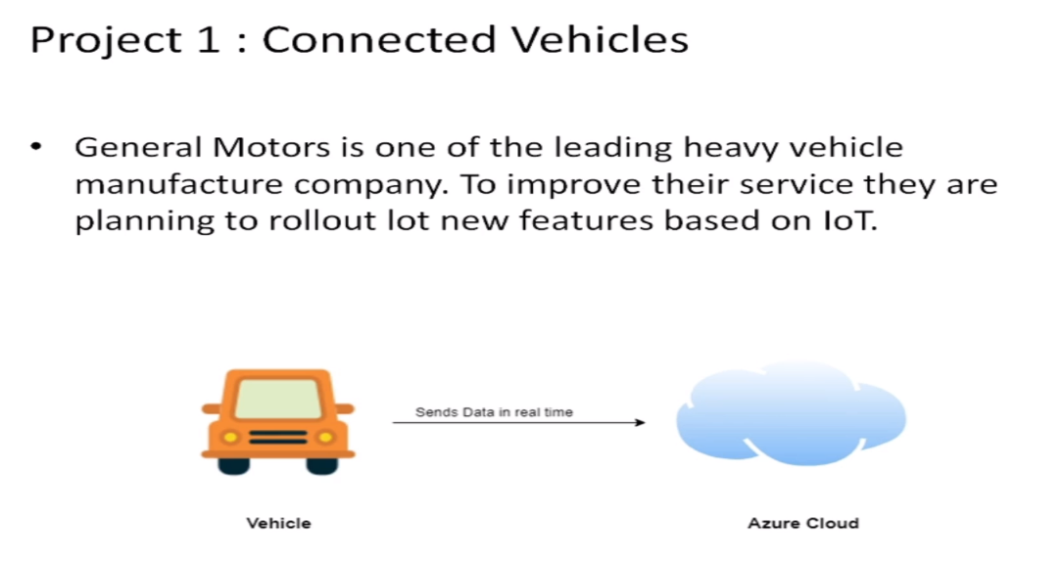

Slide 4
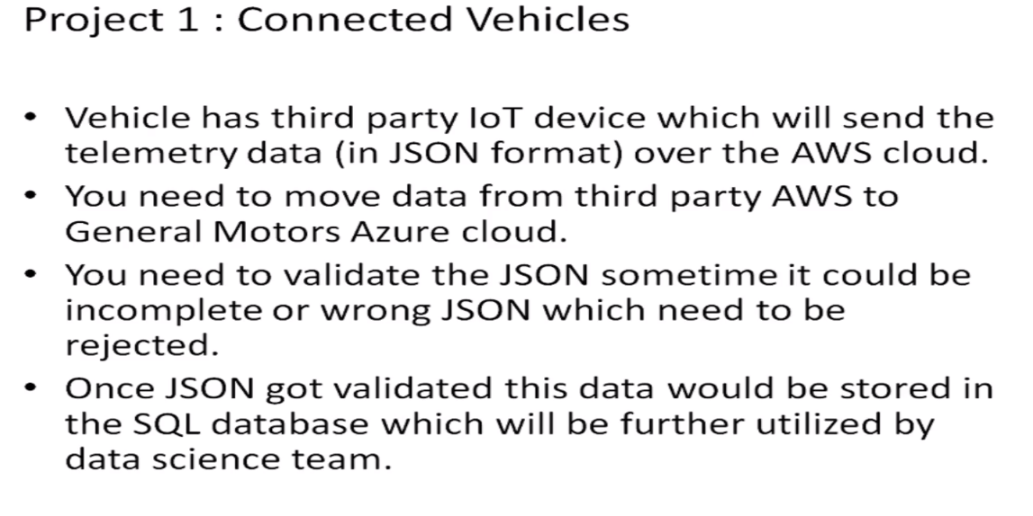
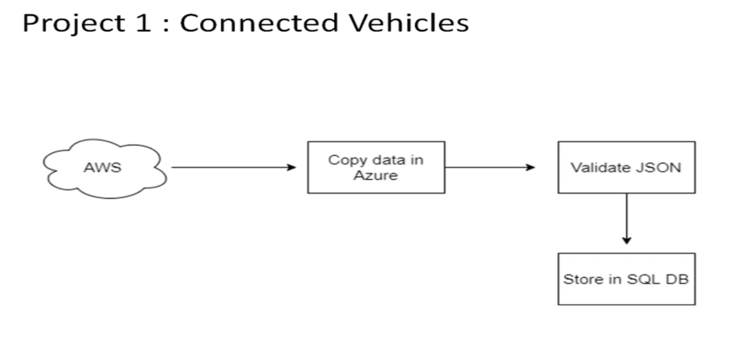

Slide 5
STEPS
1.Create Azure Data factory ana azure datafactory pipeline
2.create a blob storage
3.create storage account and sql server
4.Add another pipeline to move data from stagging sql

Slide 6
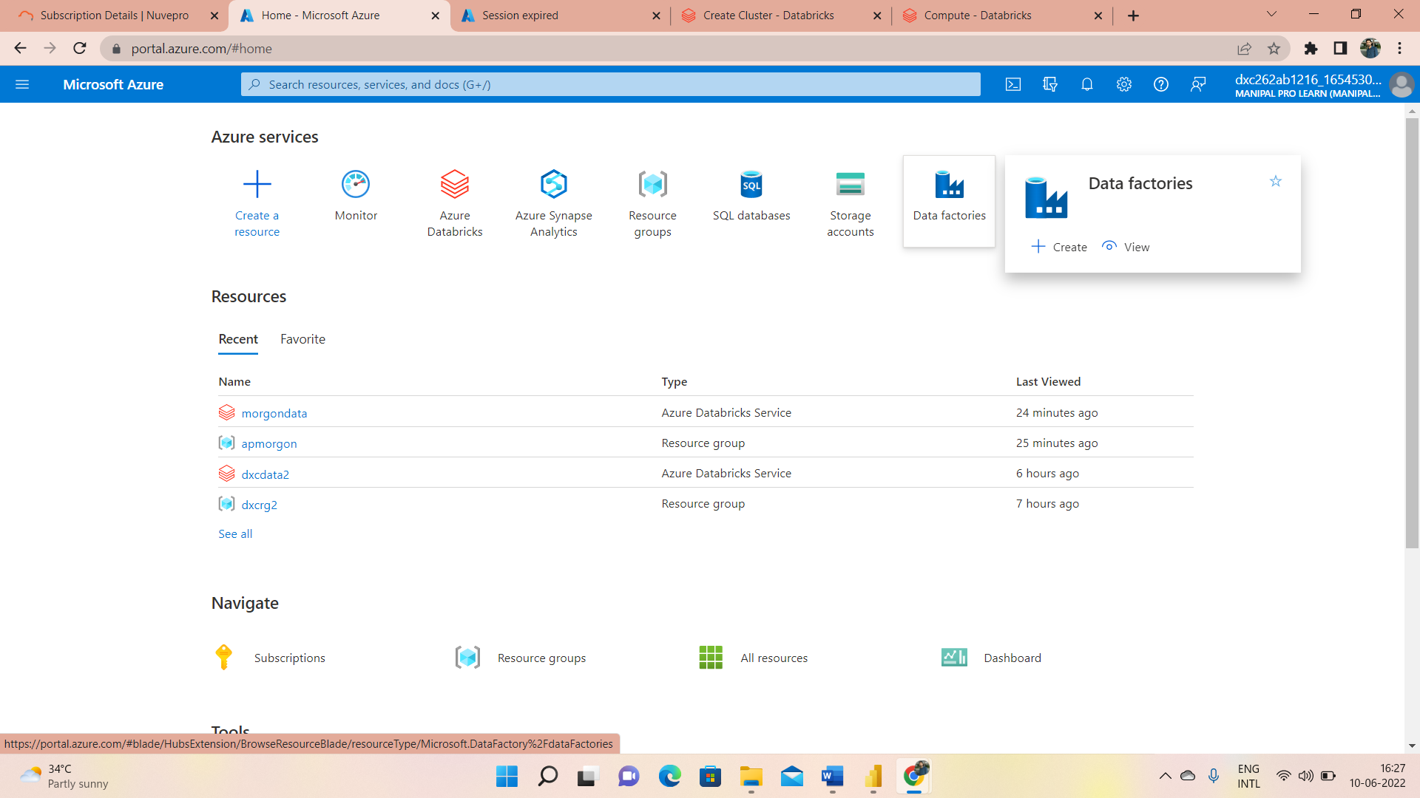
Azure Data Factory
1. Open Azure Data factory and search for Azure Data Factory

Slide 7
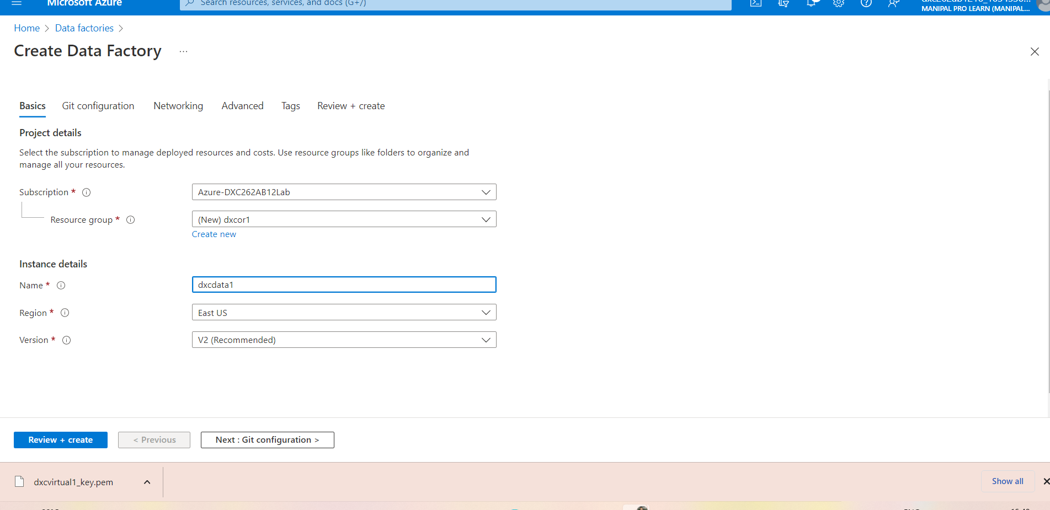
2.Here fill name,region and version

Slide 8
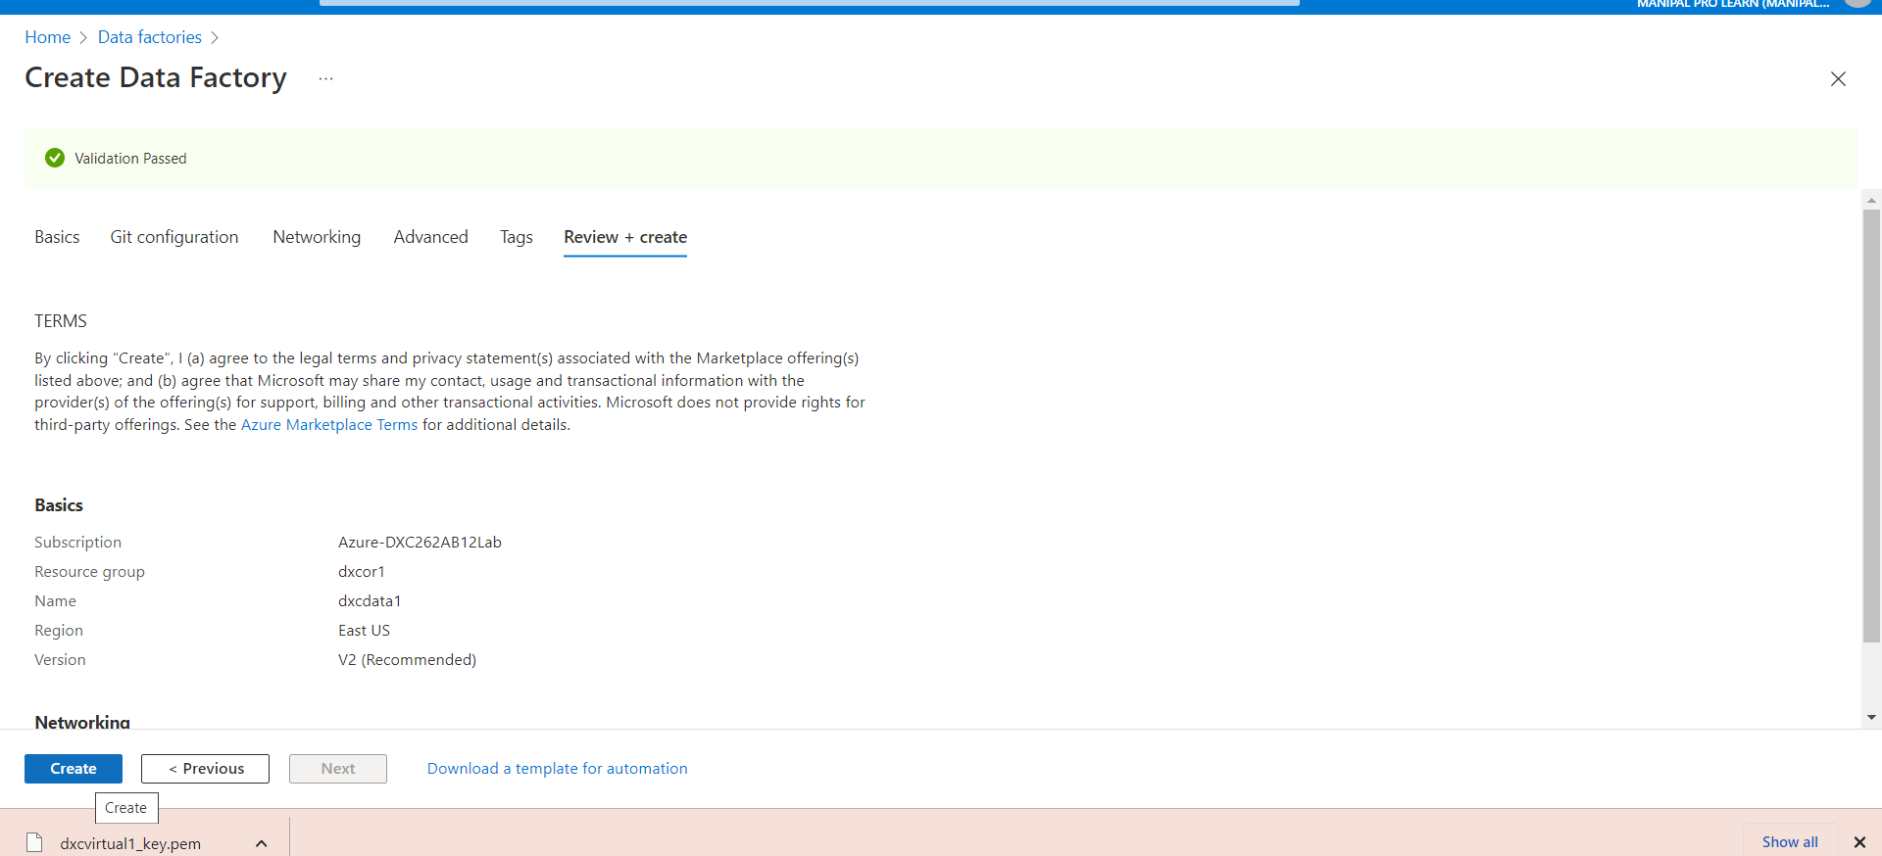
3.click on review+create

Slide 9
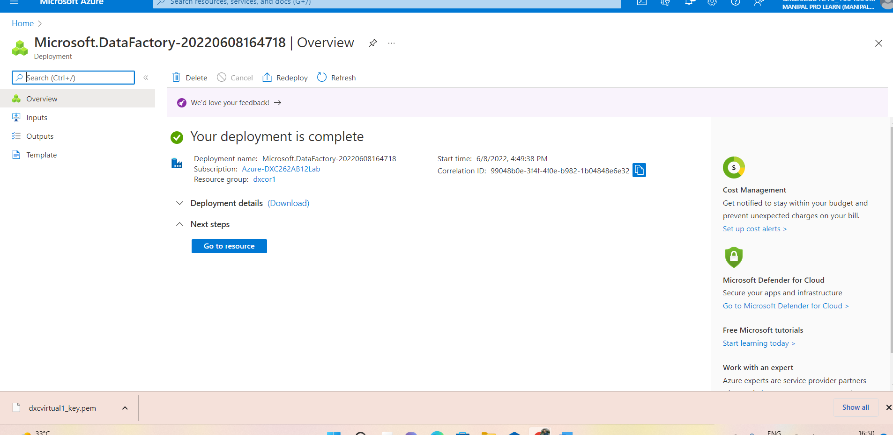
4.you will get a screen like your deployment is complete

Slide 10
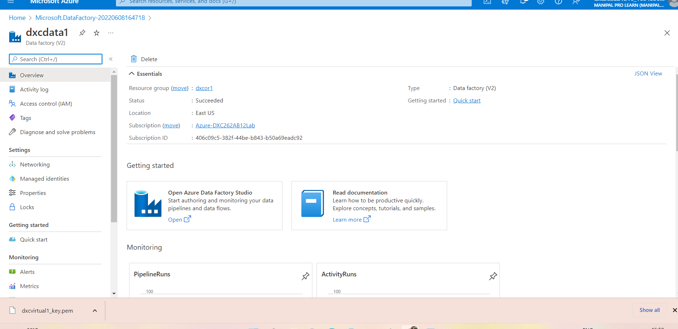
After deployment complete, Go to the resource group then you will get
Click on open

Slide 11
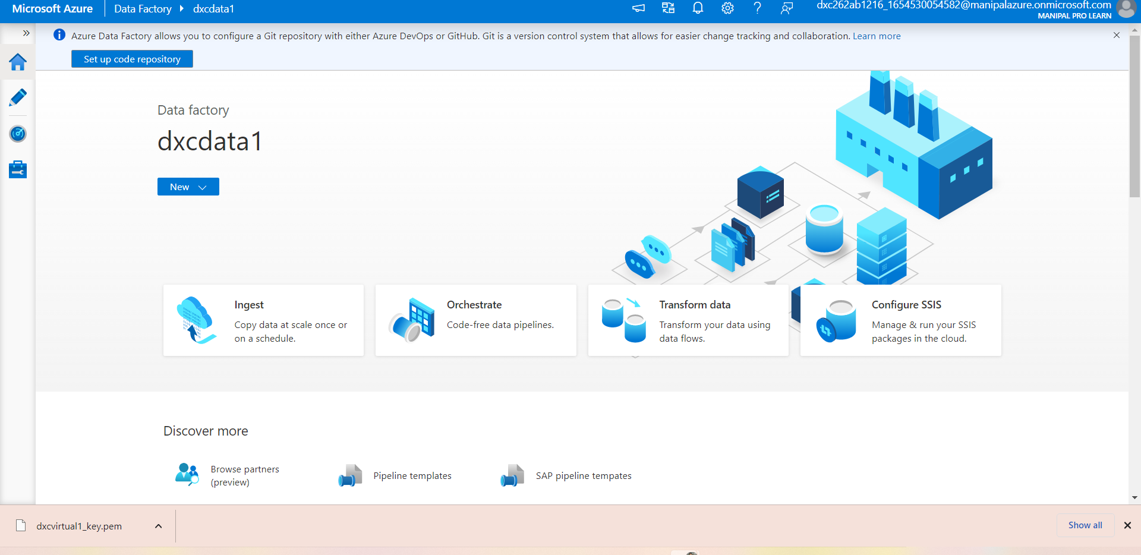
Click on open Azure Factory

Slide 12
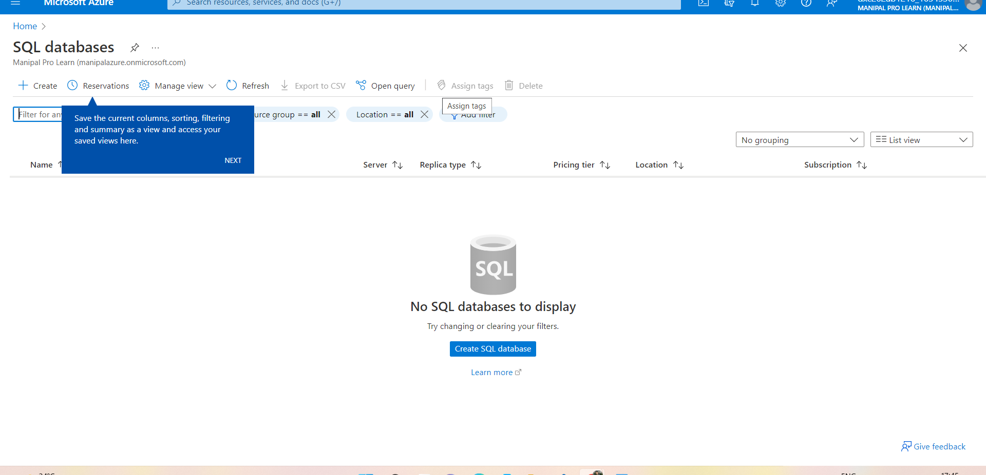
Create SQL Server And Database

Slide 13
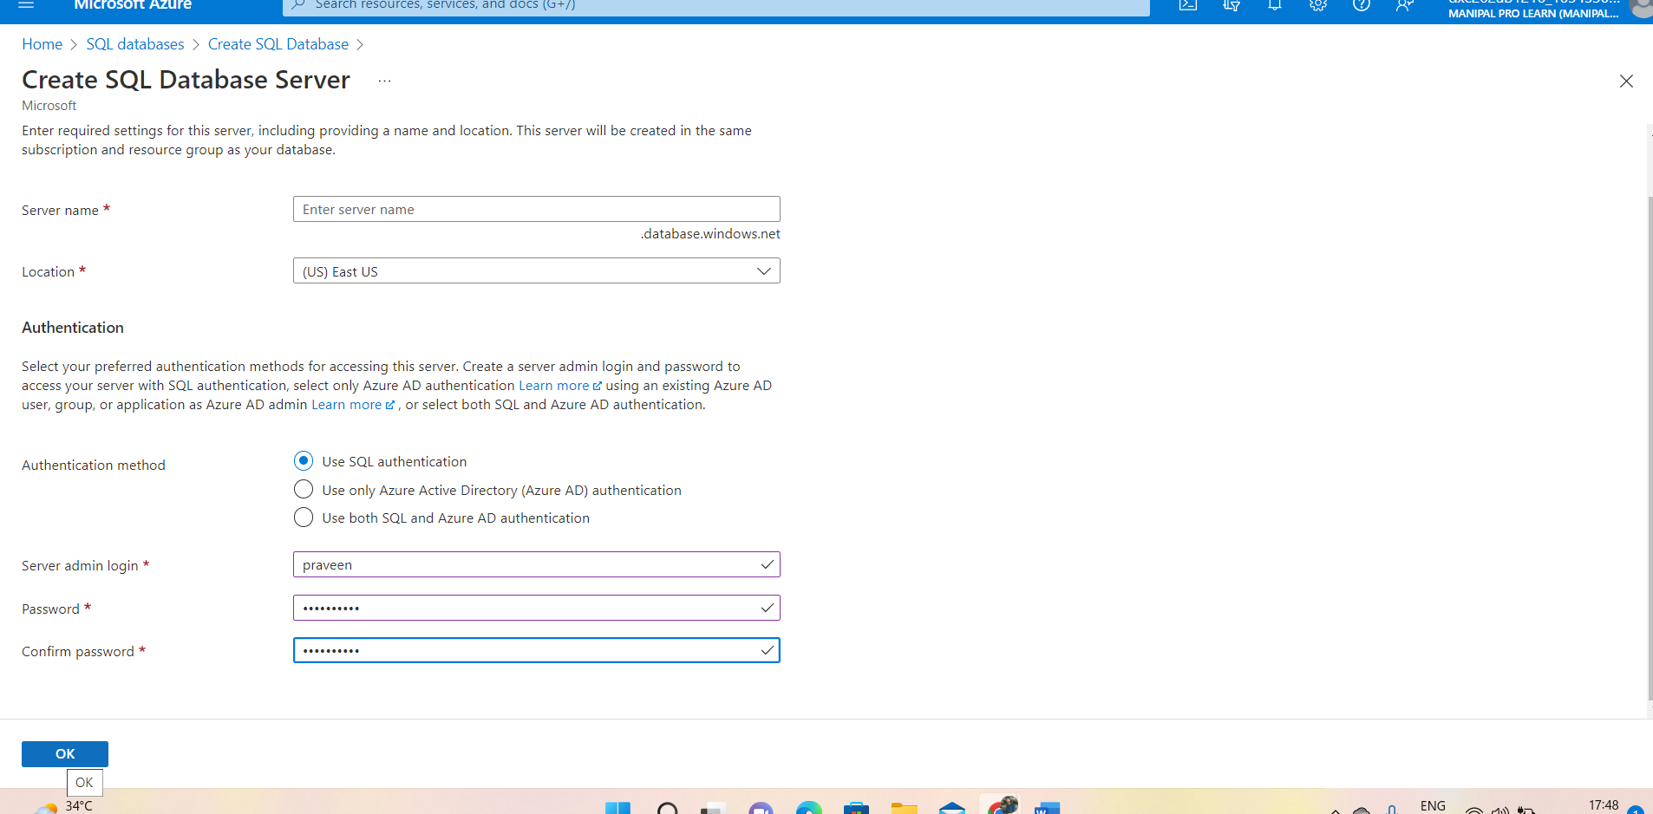
Create SQL server Data base 1.1.Fill server name Admin login and password

Slide 14
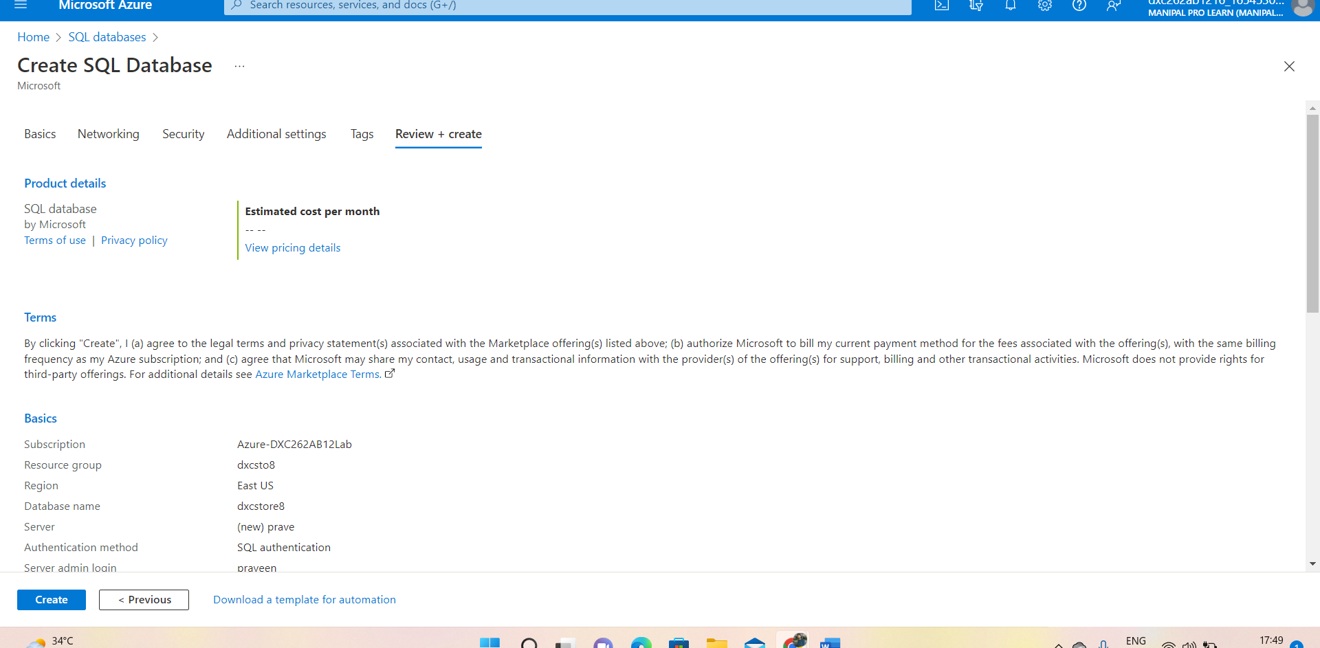
Click on review + create

Slide 15
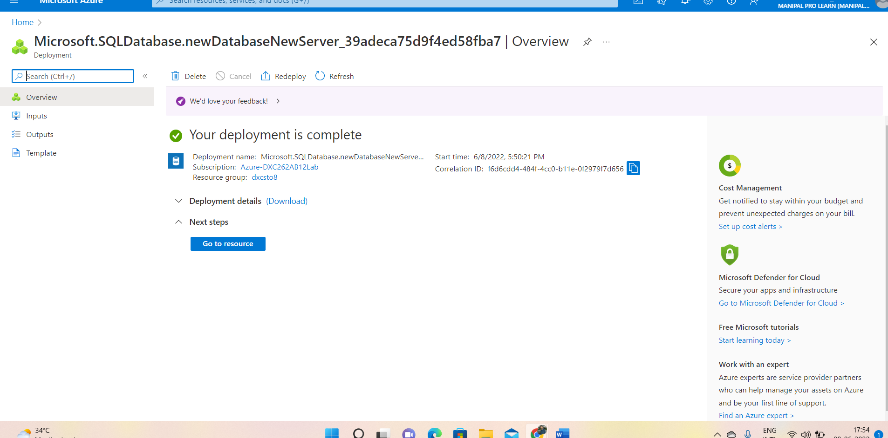
Click on Go to Resource

Slide 16
1.After these steps come back to Azure data factory
1.1. Click on ingest
1.2.Go to storage account and create Two containers
1.3.select source type as blob storage and target as Azure SQL Database
1.4.click on next
2.here we will link data factoty with sql database
2.1.then,connect the database with new connection
2.2. click on validate data-→connection-→click on next
2.3.so that pipeline navigate.

Slide 17
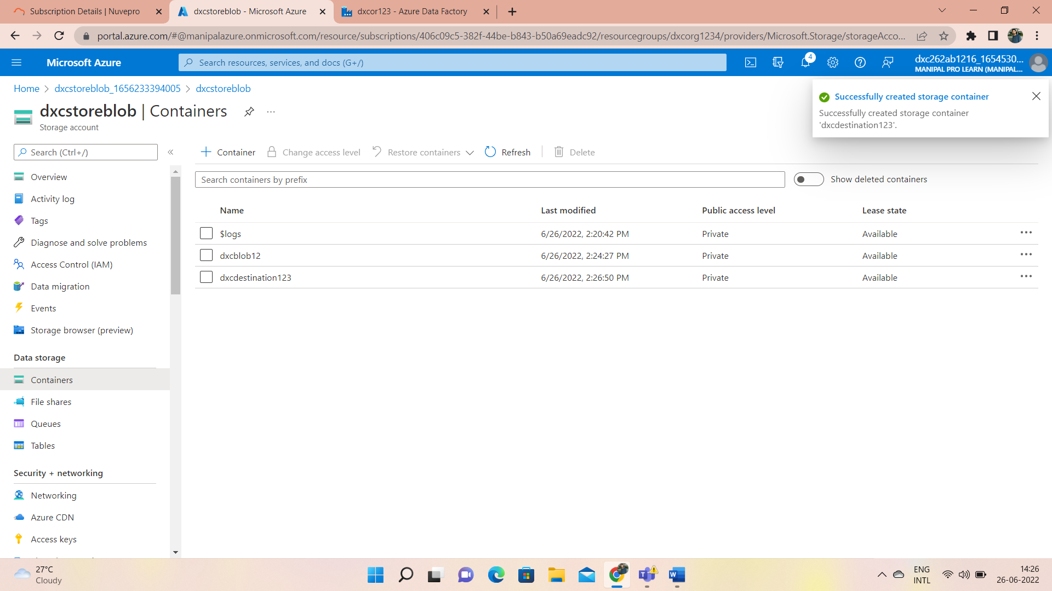
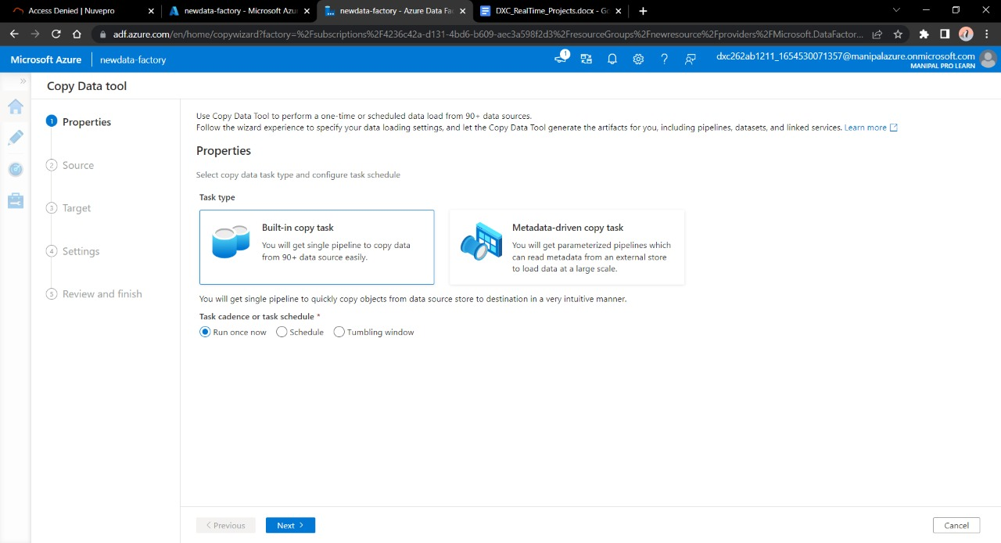
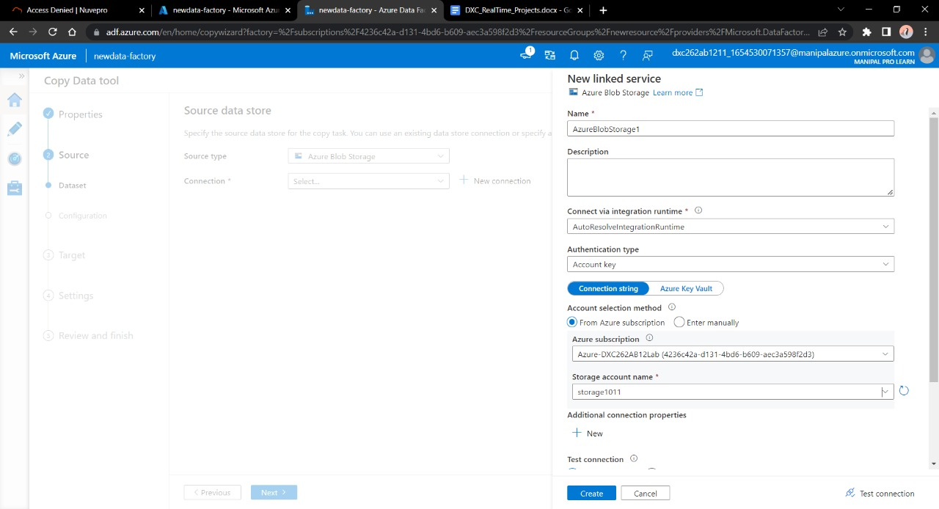
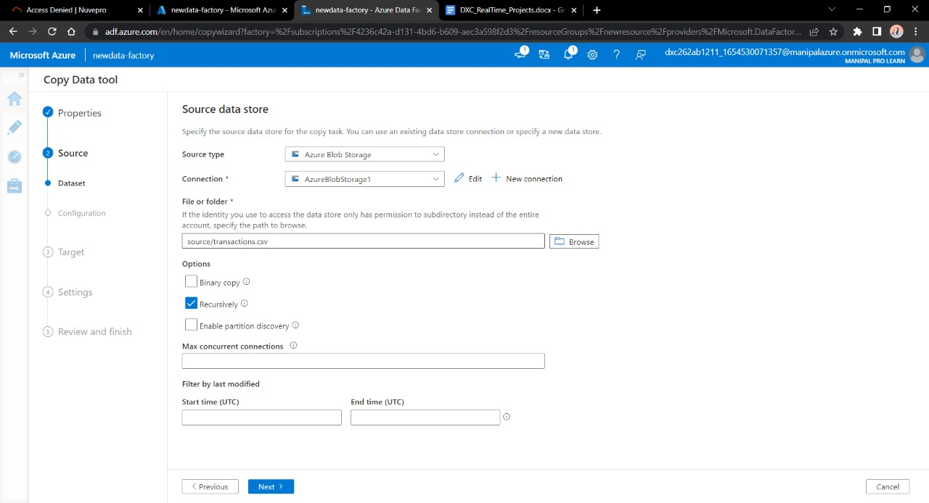

Slide 18
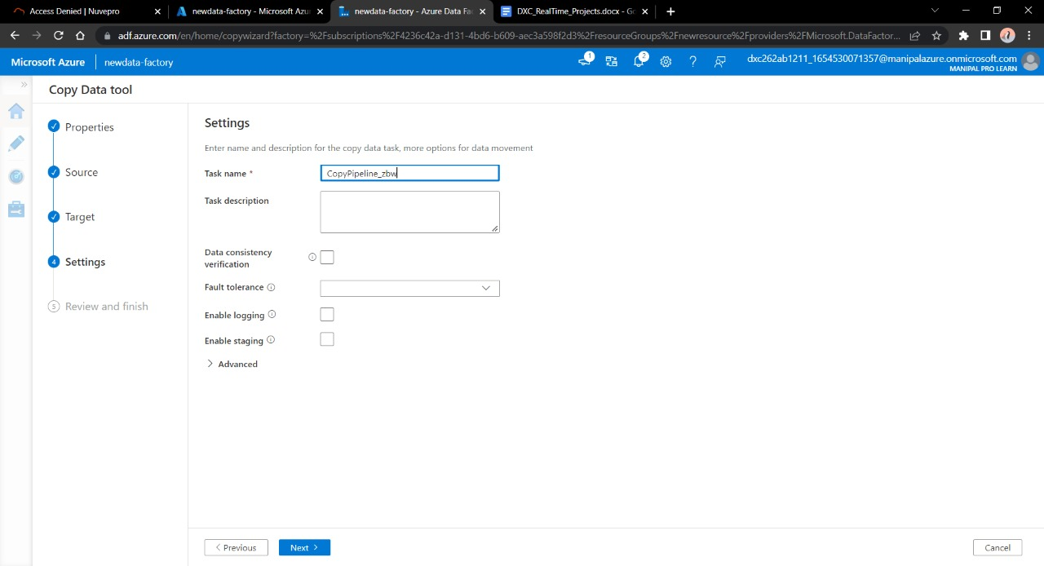
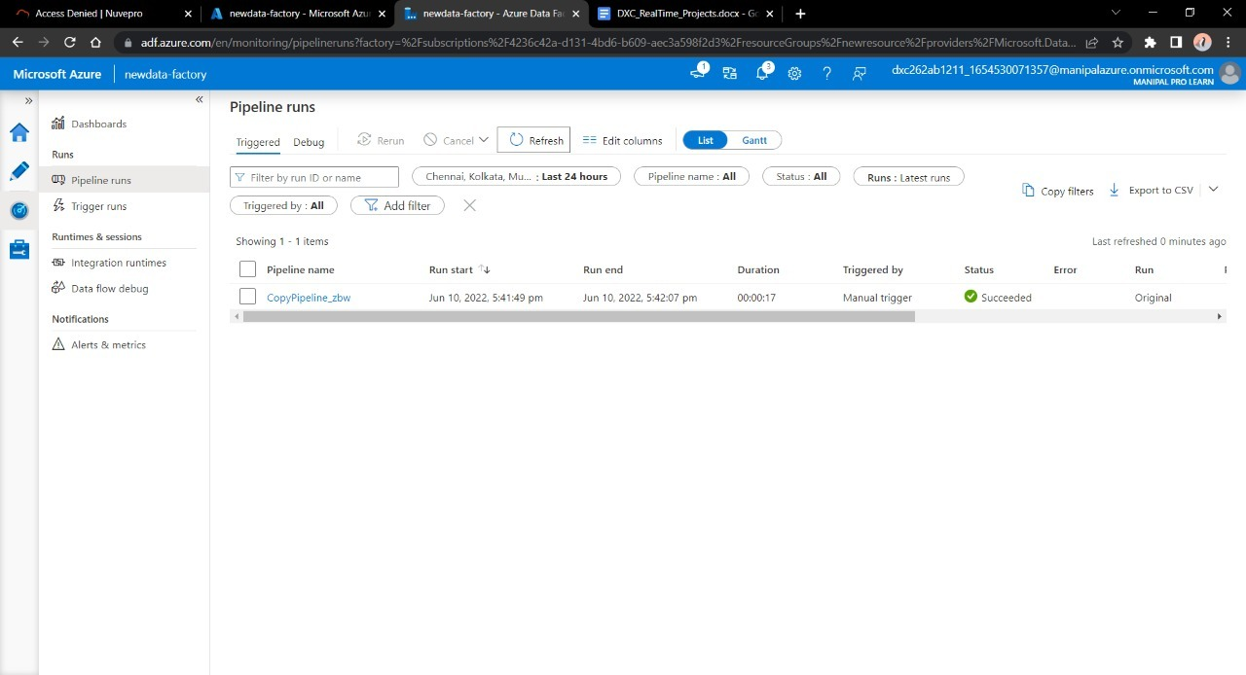
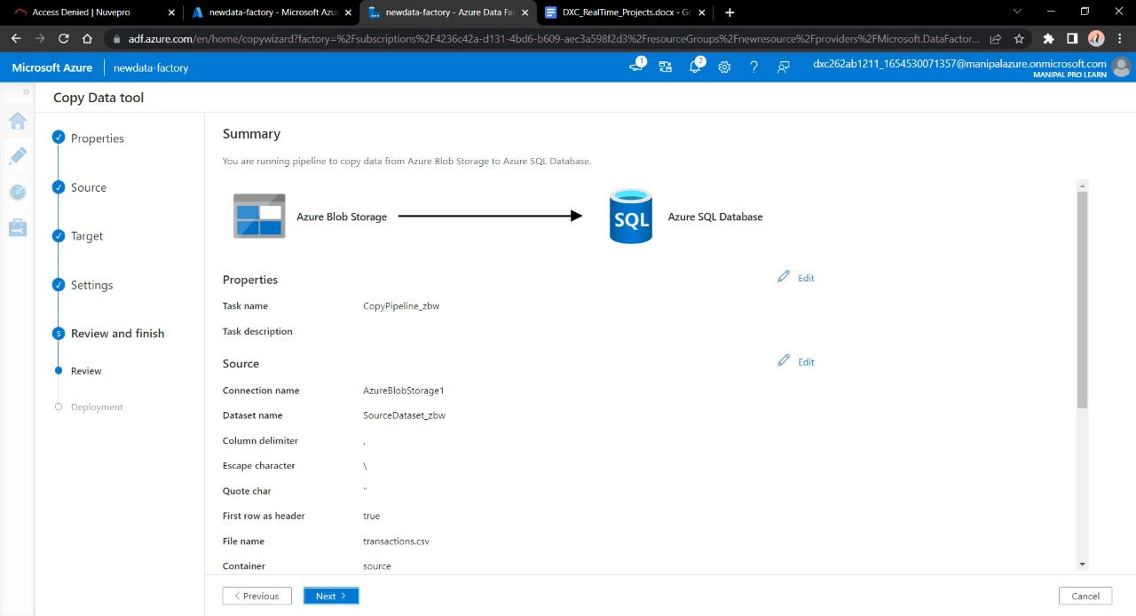
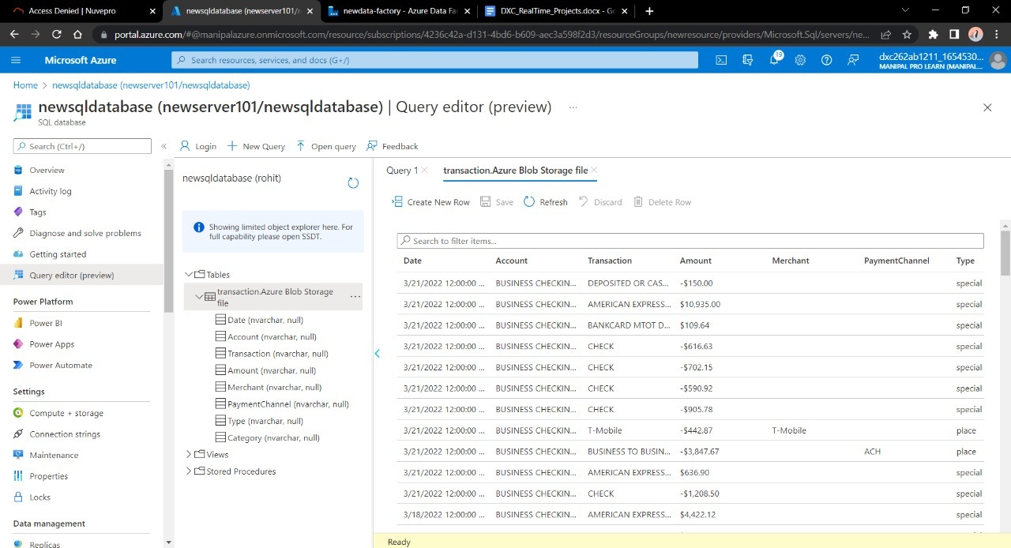
3.Go towards SQL database to check the data

Slide 19
Result: In this project we were successful in creating a pipeline that will validate and copy the blob data into the SQL database using Azure Data Factory
Conclusion: The Blob data is being successfully validated and stored into SQL database.

Slide 20
NAME: Bandi Praveen Kumar
Reg No:DXC262ab1216
Project: AP Morgon Data Platform
Date: 10-06-2022

Slide 21
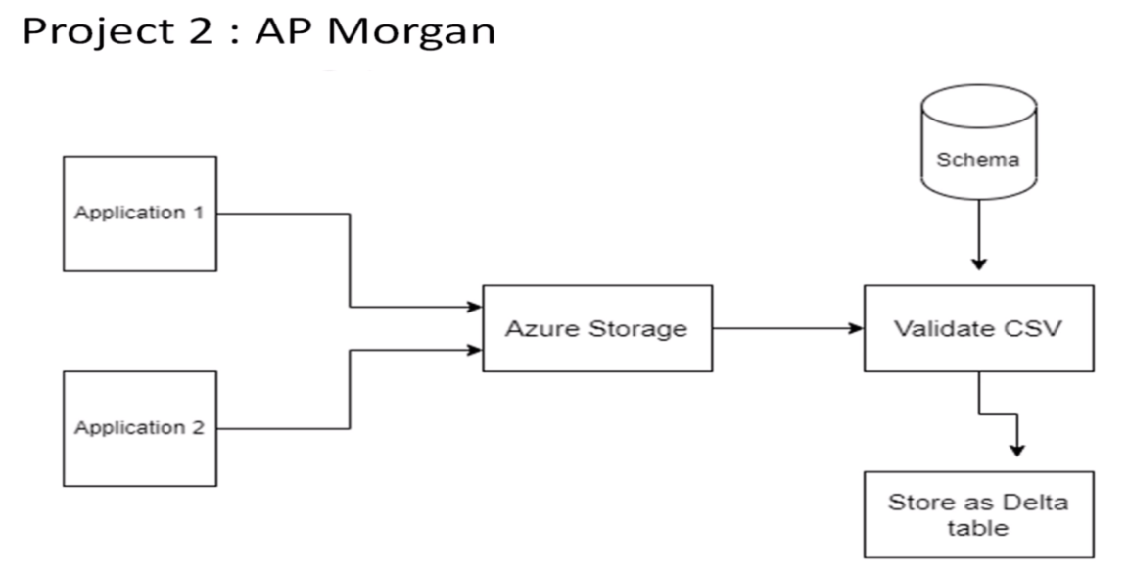

Slide 22
STEPS
1.Creation of databricks
2.Creation Of Cluster
3.Add Notebook on databricks
4.Generate a new token as AP Morgon
5.Choose the notebook in pipeline to trigger
6.Click on trigger and check the status

Slide 23
Creation of Databricks
1.Go to azure platfom
1.1 search for data bricks
2.Basics
2.1. create a resource name
2.2. workspace name
3.click on Review + create
3.1. wait for validation succeeded
3.2.click on create and wait for deployment then click on launch work space

Slide 24
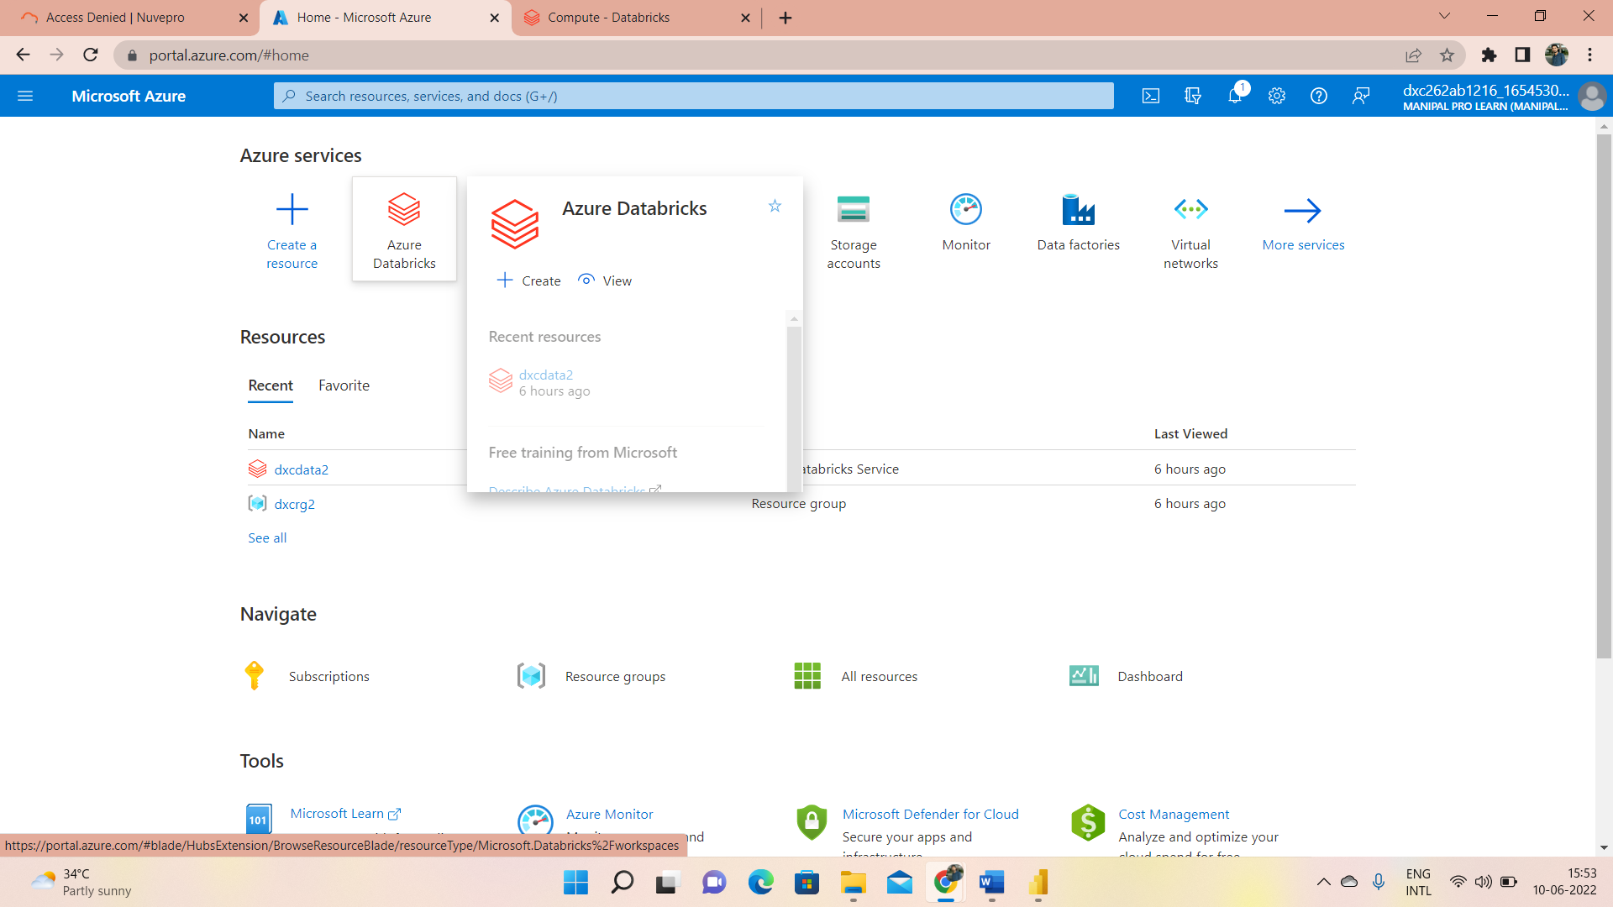
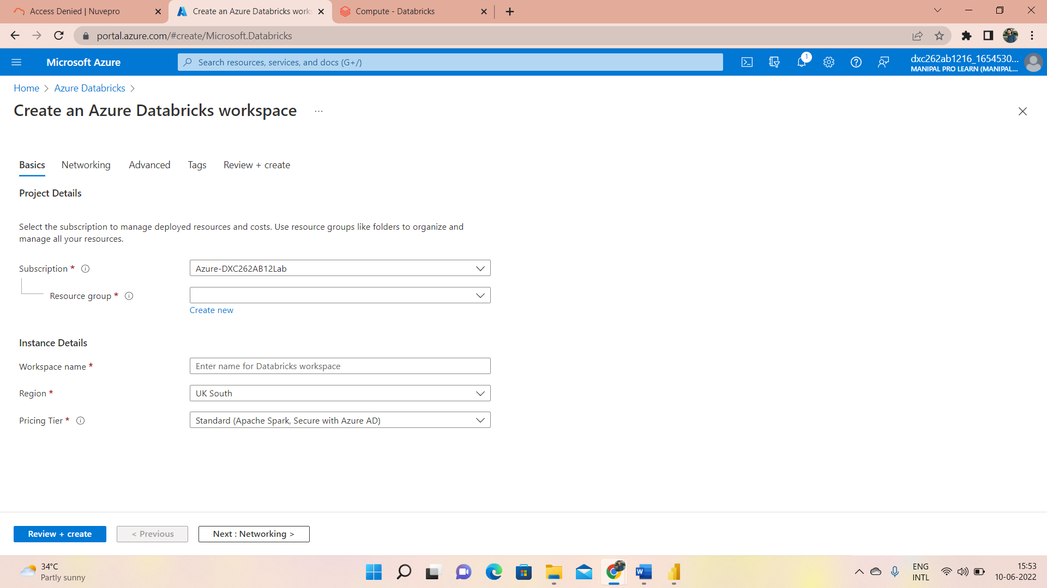
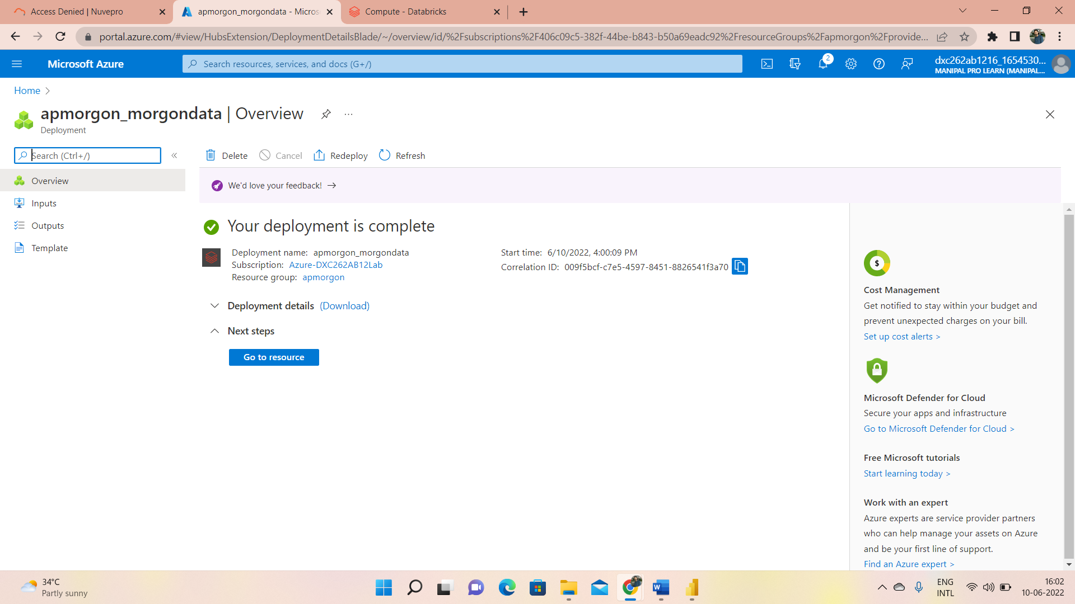
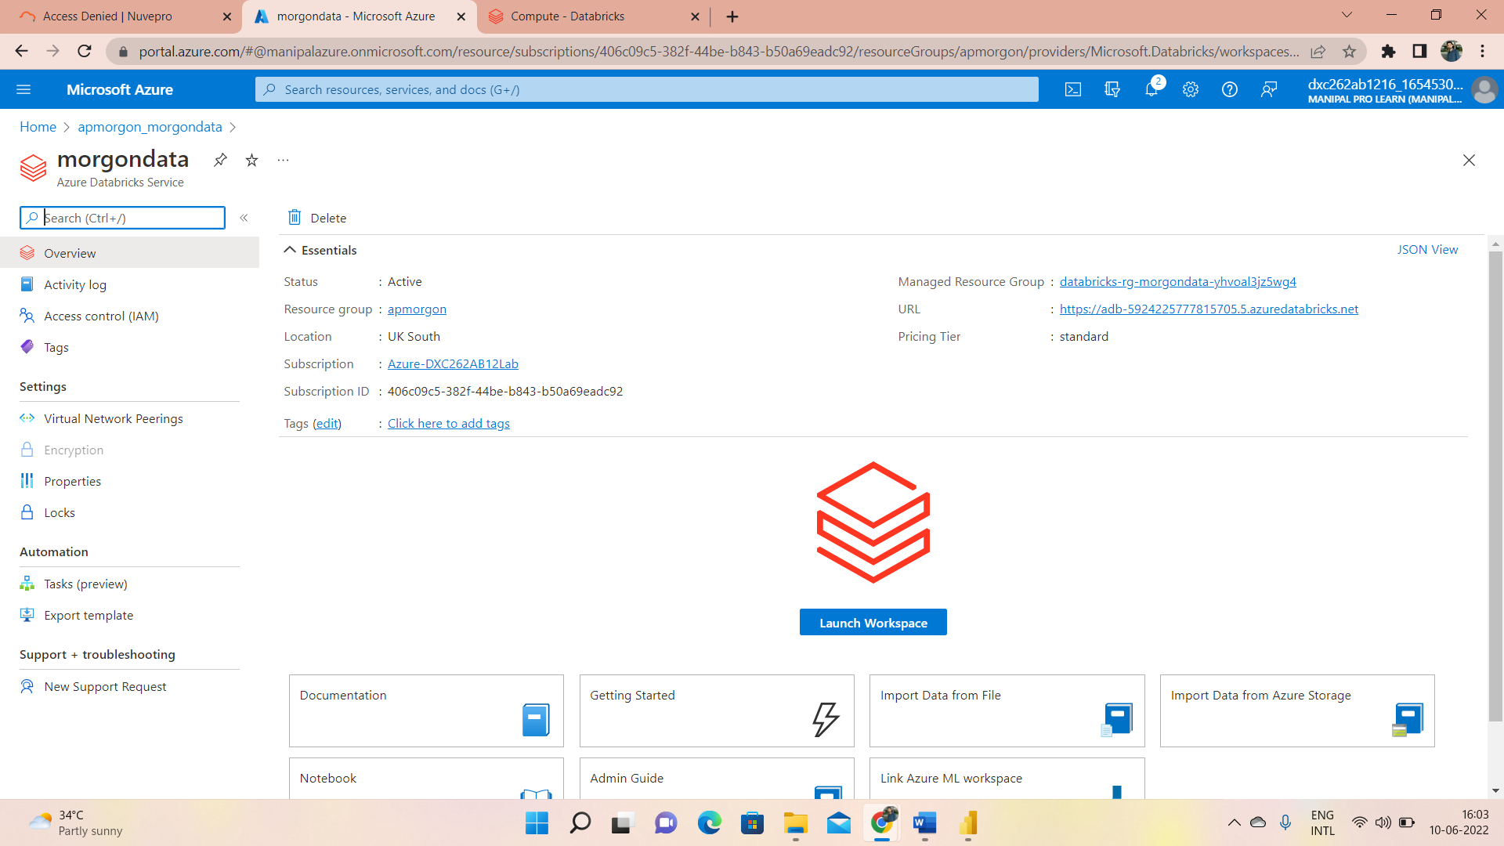

Slide 25
Creation of Cluster Databricks
1.1 on Set up your workspace--→ click on create a cluster
1.2 Create a cluster
--→Create a name to cluster
cluster mode→ standard
Terminate time:-30min

Slide 26
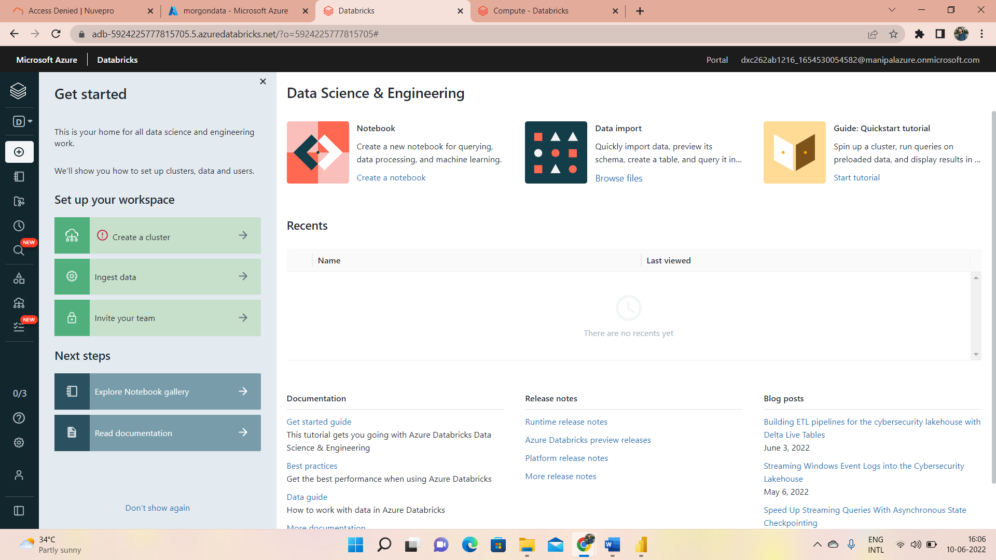
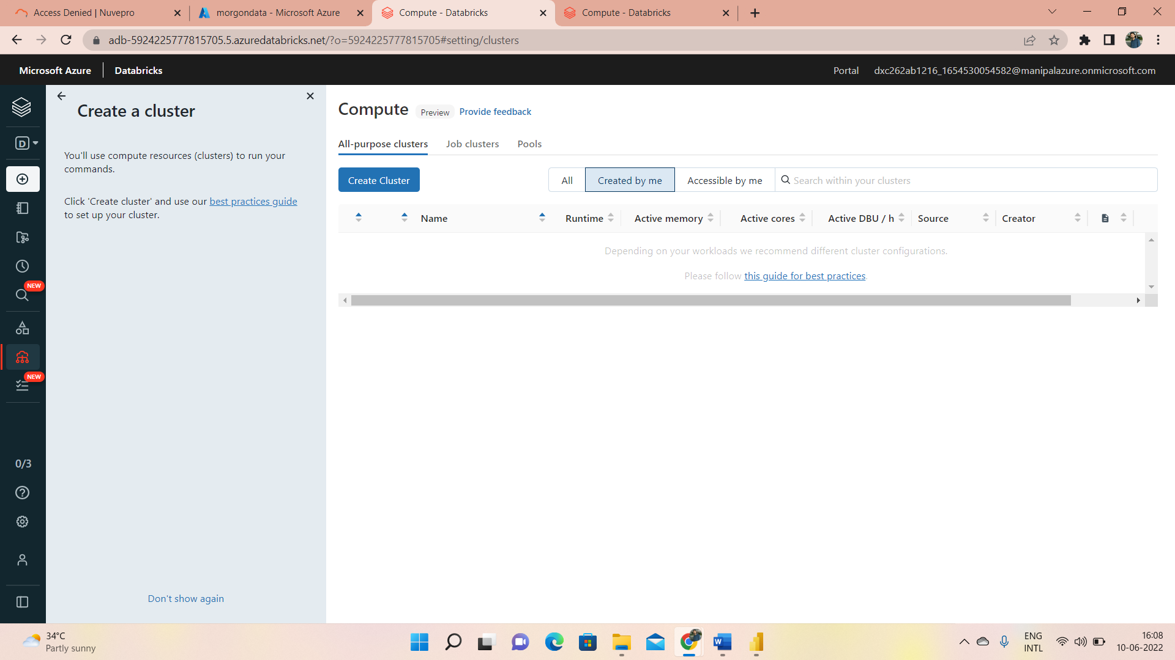
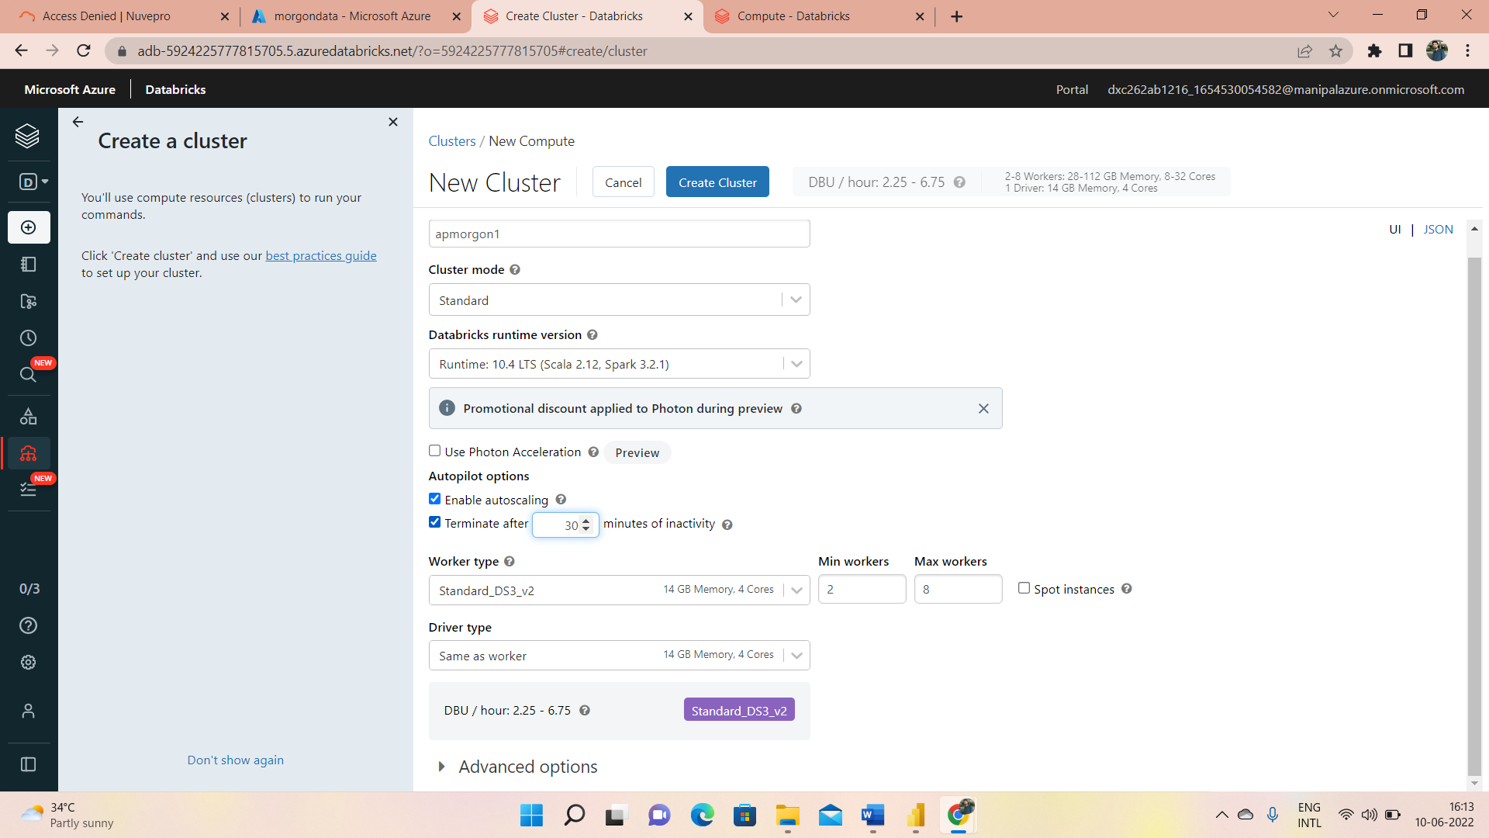
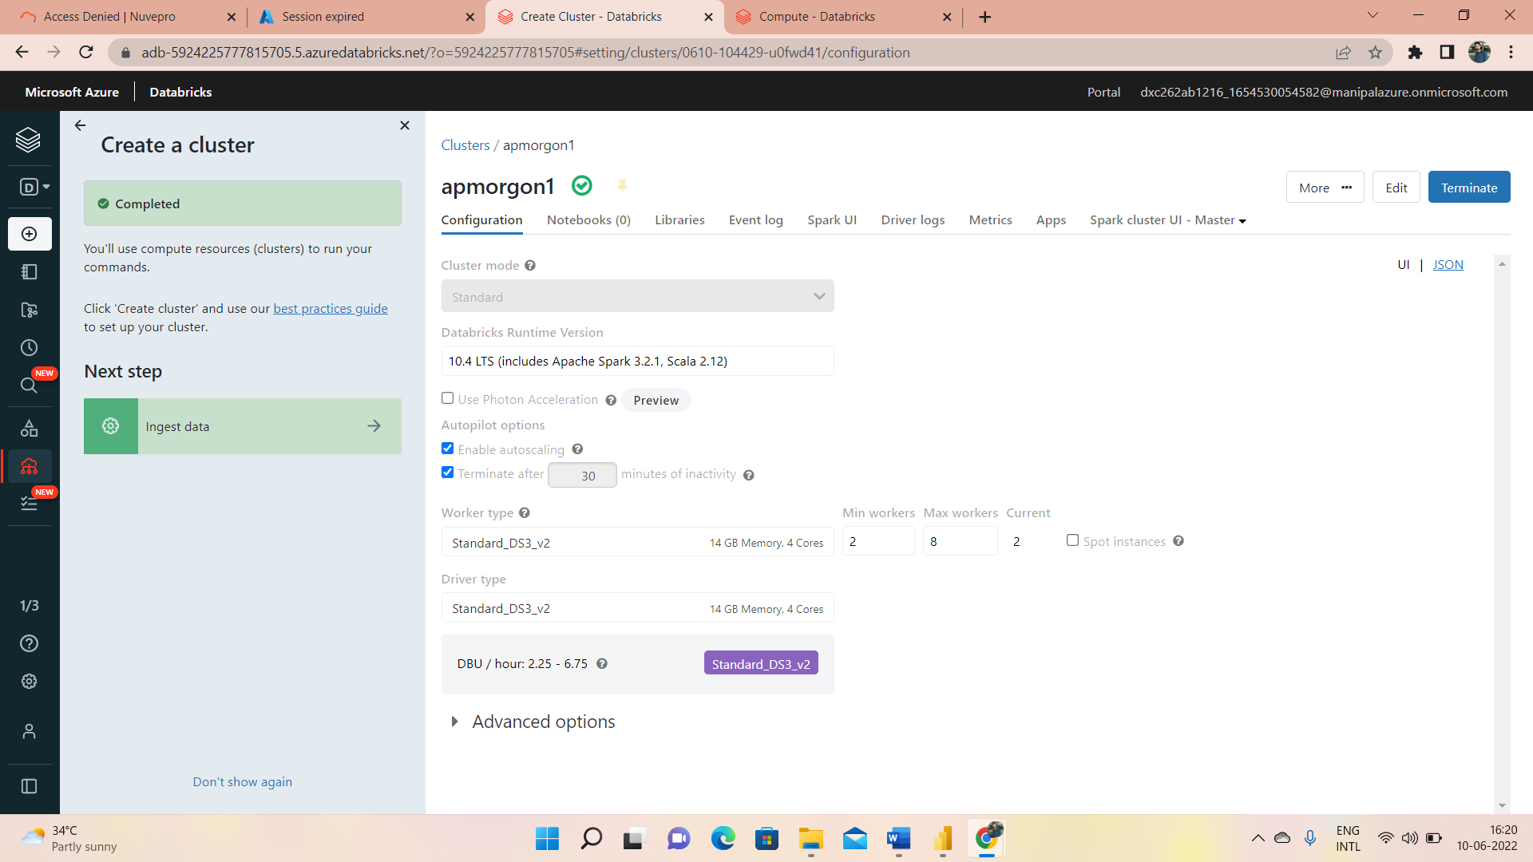

Slide 27
Add notebook in Data bricks
1. 1create-→workspace→create-→notebook
1.1 Then create a notebook
name-→demodxc1
default language-> python
cluster→dxccluster1

Slide 28
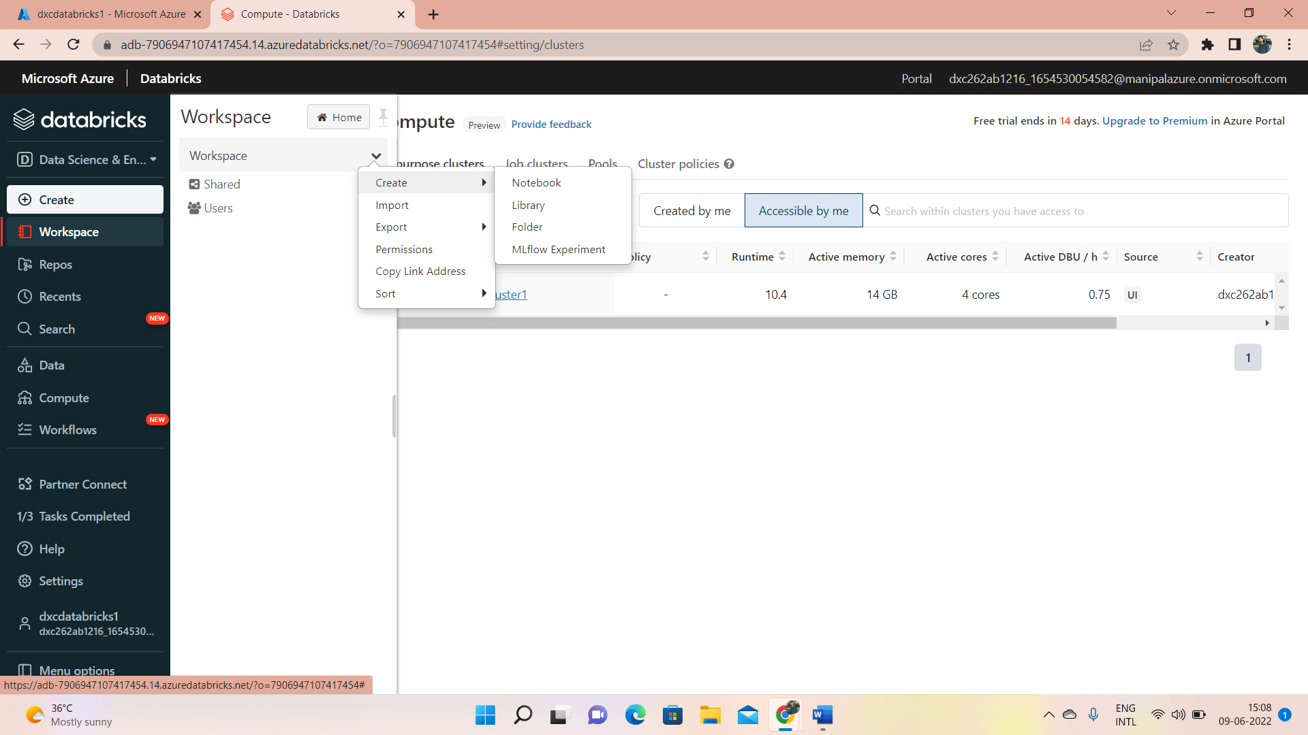
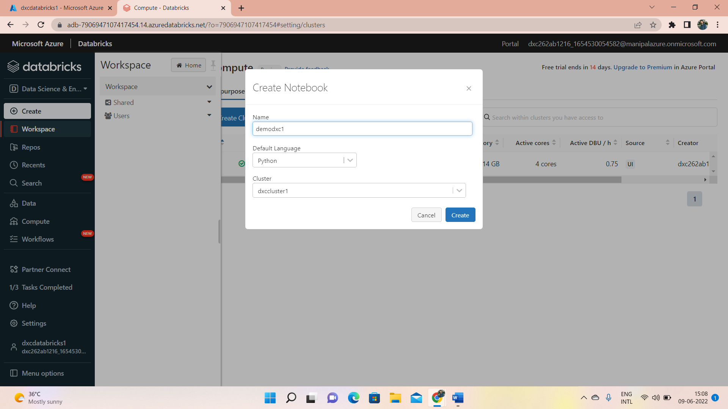
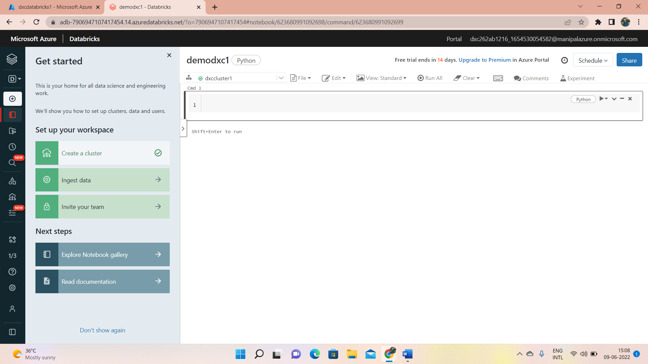

Slide 29
Azure Datafactory for data morgon
1.open Microsoft azure
1.1. click on datafactory
1.1.click on create
2.on Basics
2.1.fill resource group,name and region version(V2)
3. click on Review+ create

Slide 30
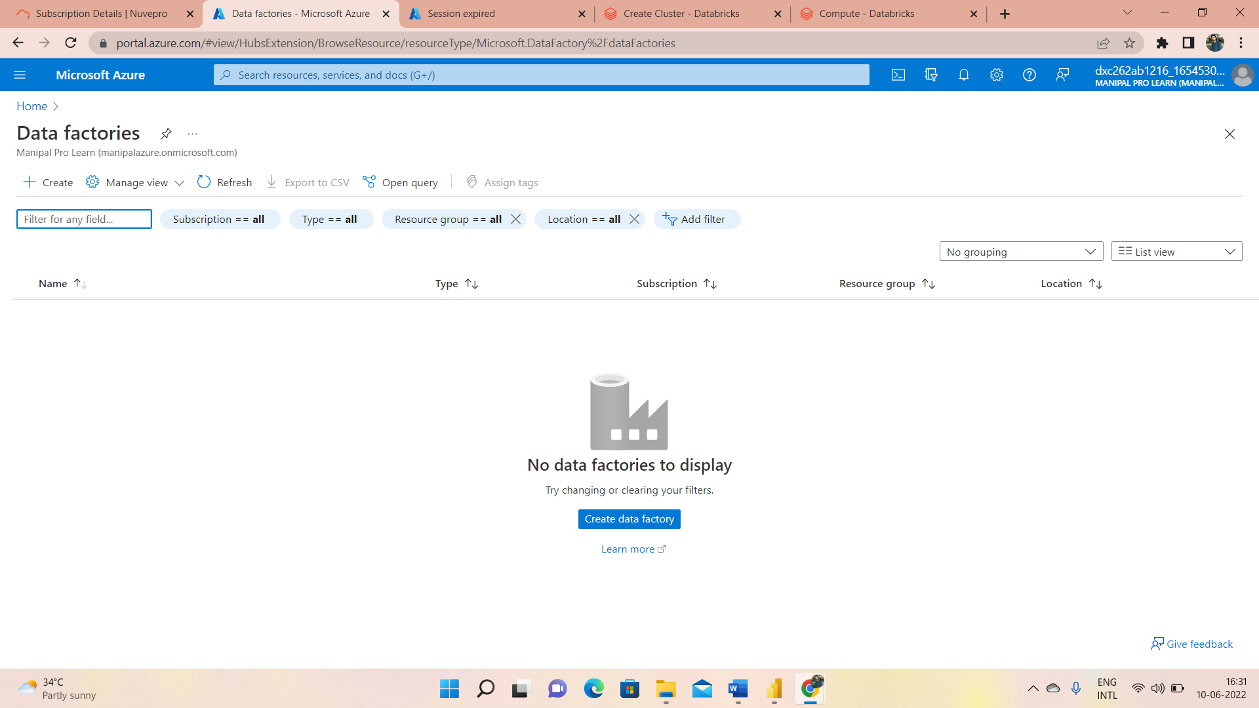
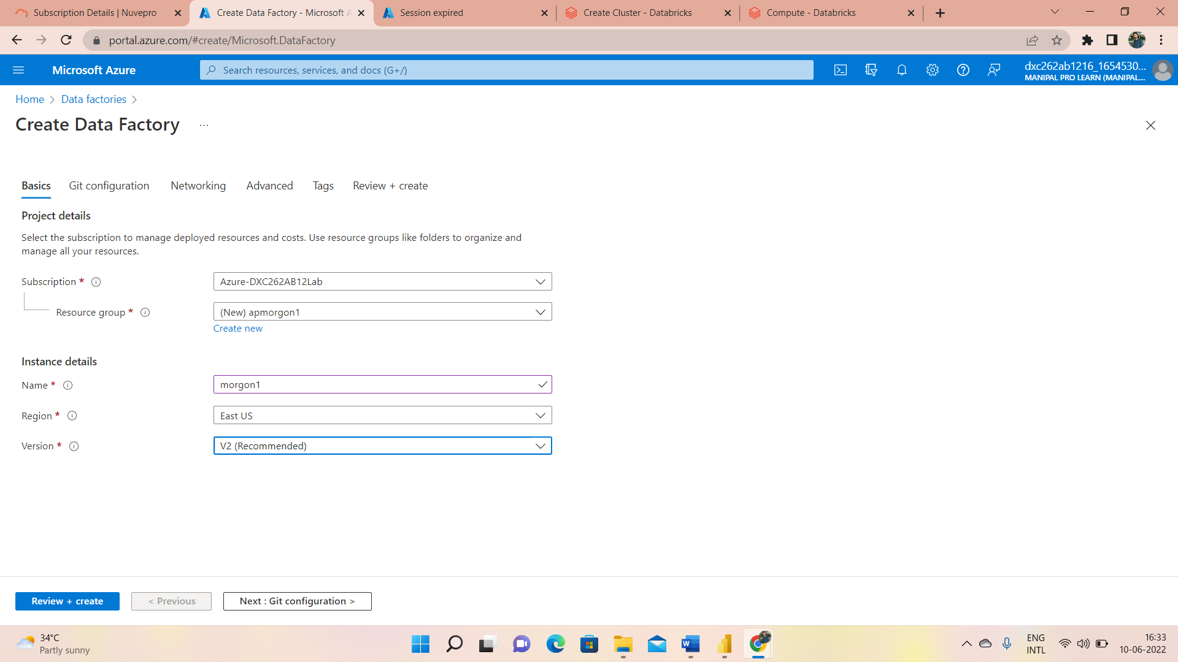
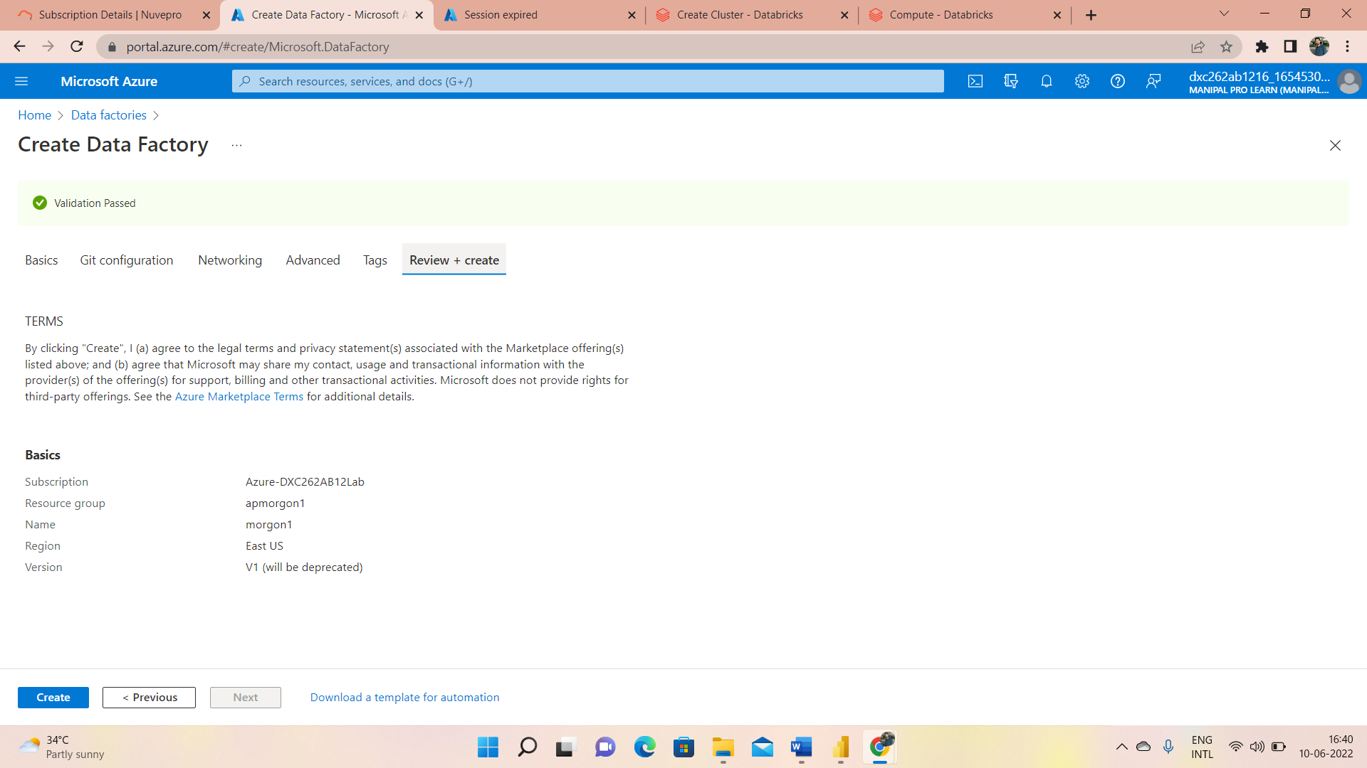

Slide 31
4.click on generate new token
4.1.Give token as AP morgon
4.2.mention life time days would be-30
4.3.click on generate
5.Choose the notebook in the pipeline to trigger
5.1.After the publish done click on trigger now
5.2.Go to the generated token and check the status

Slide 32
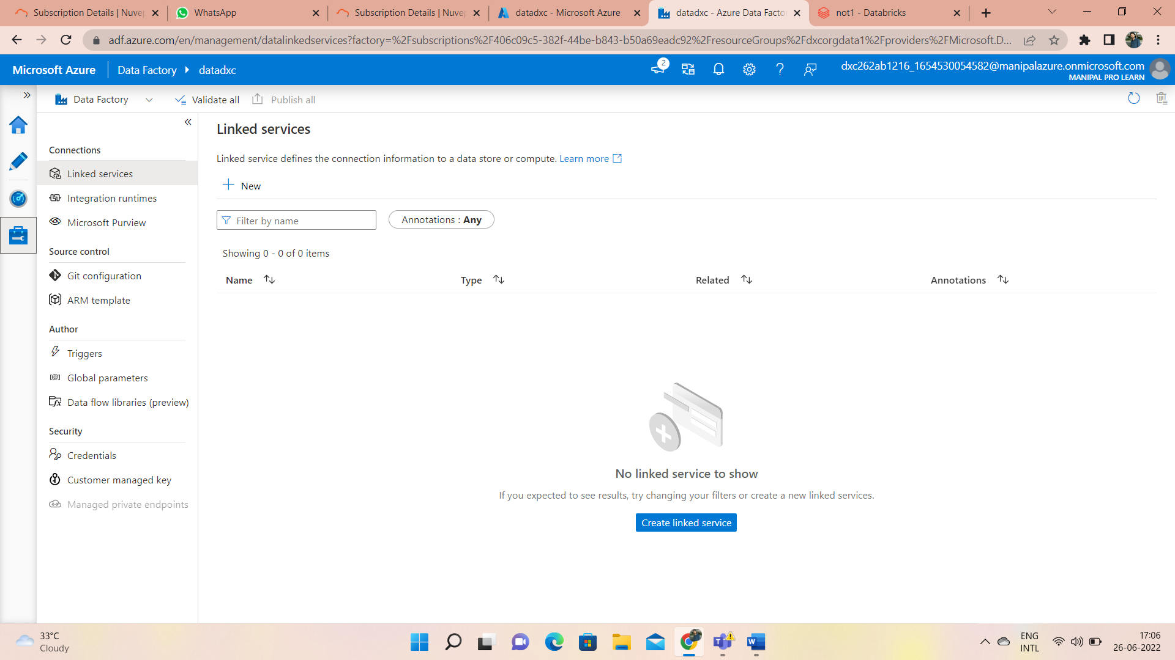
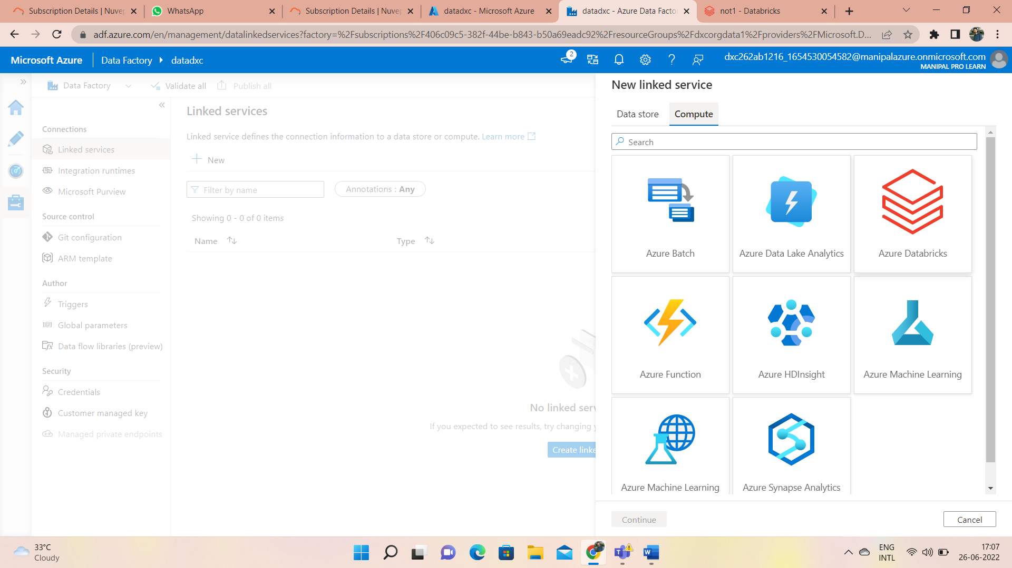
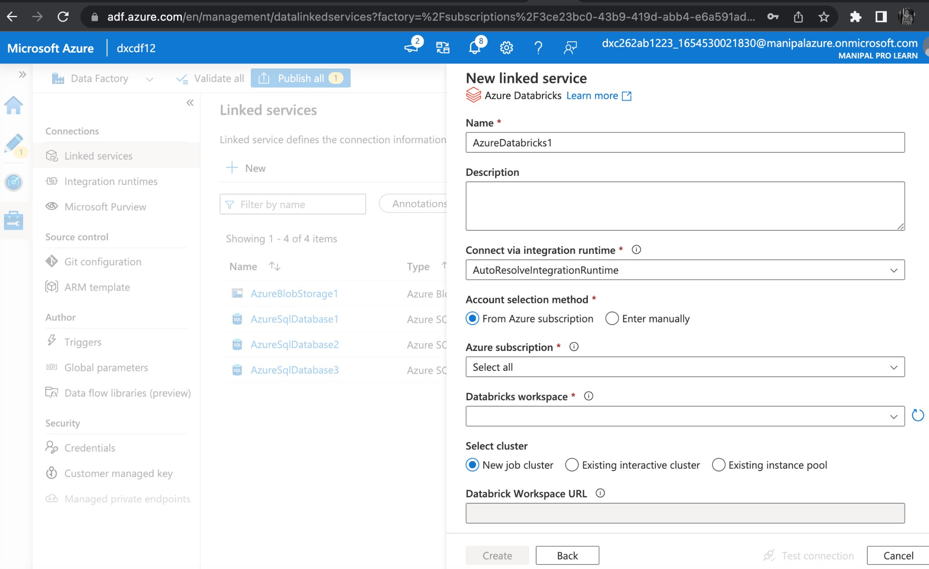
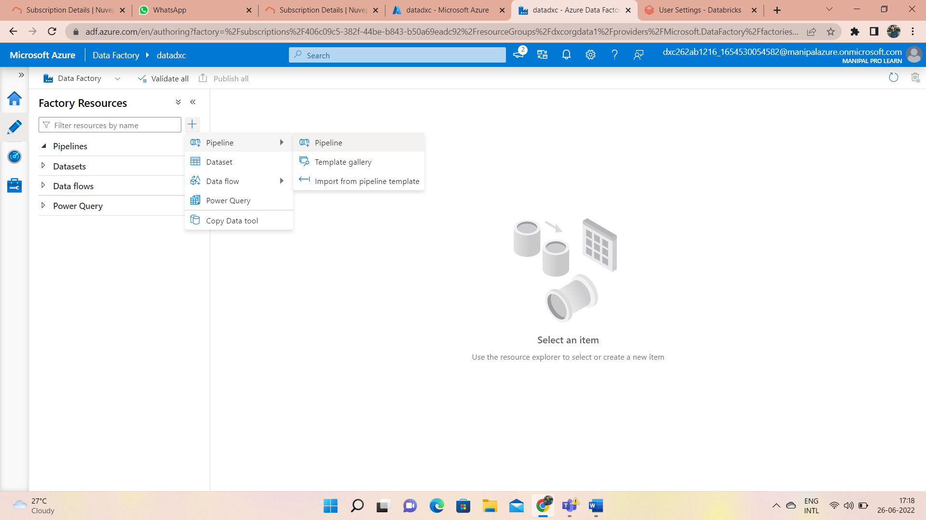

Slide 33
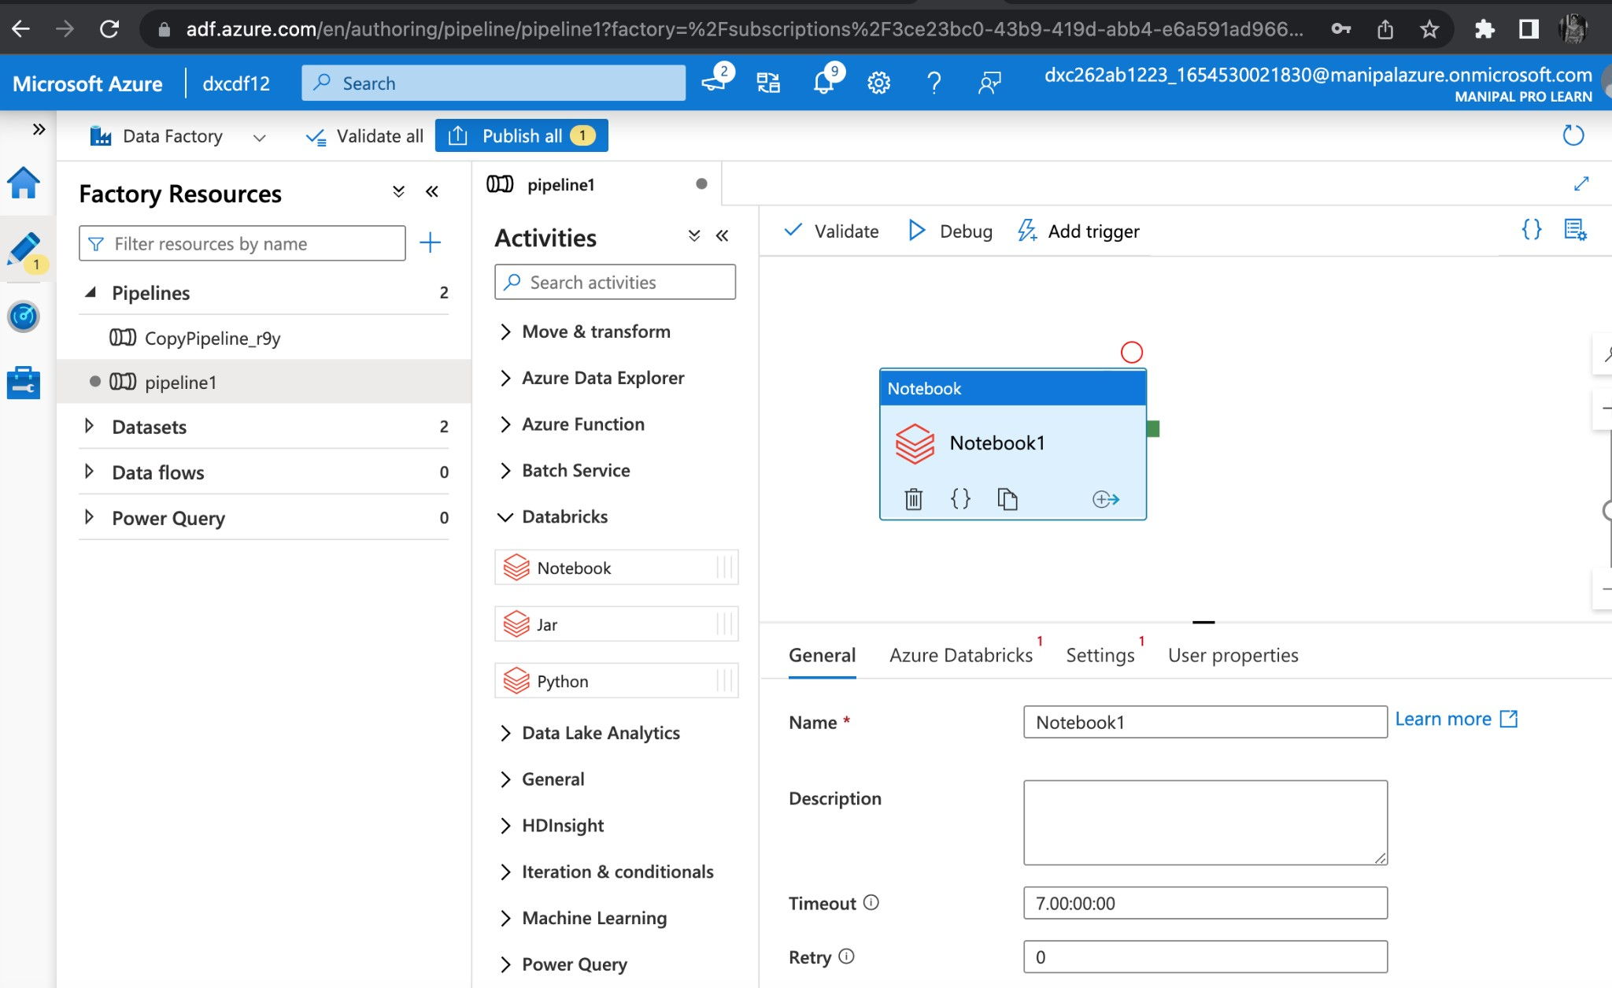
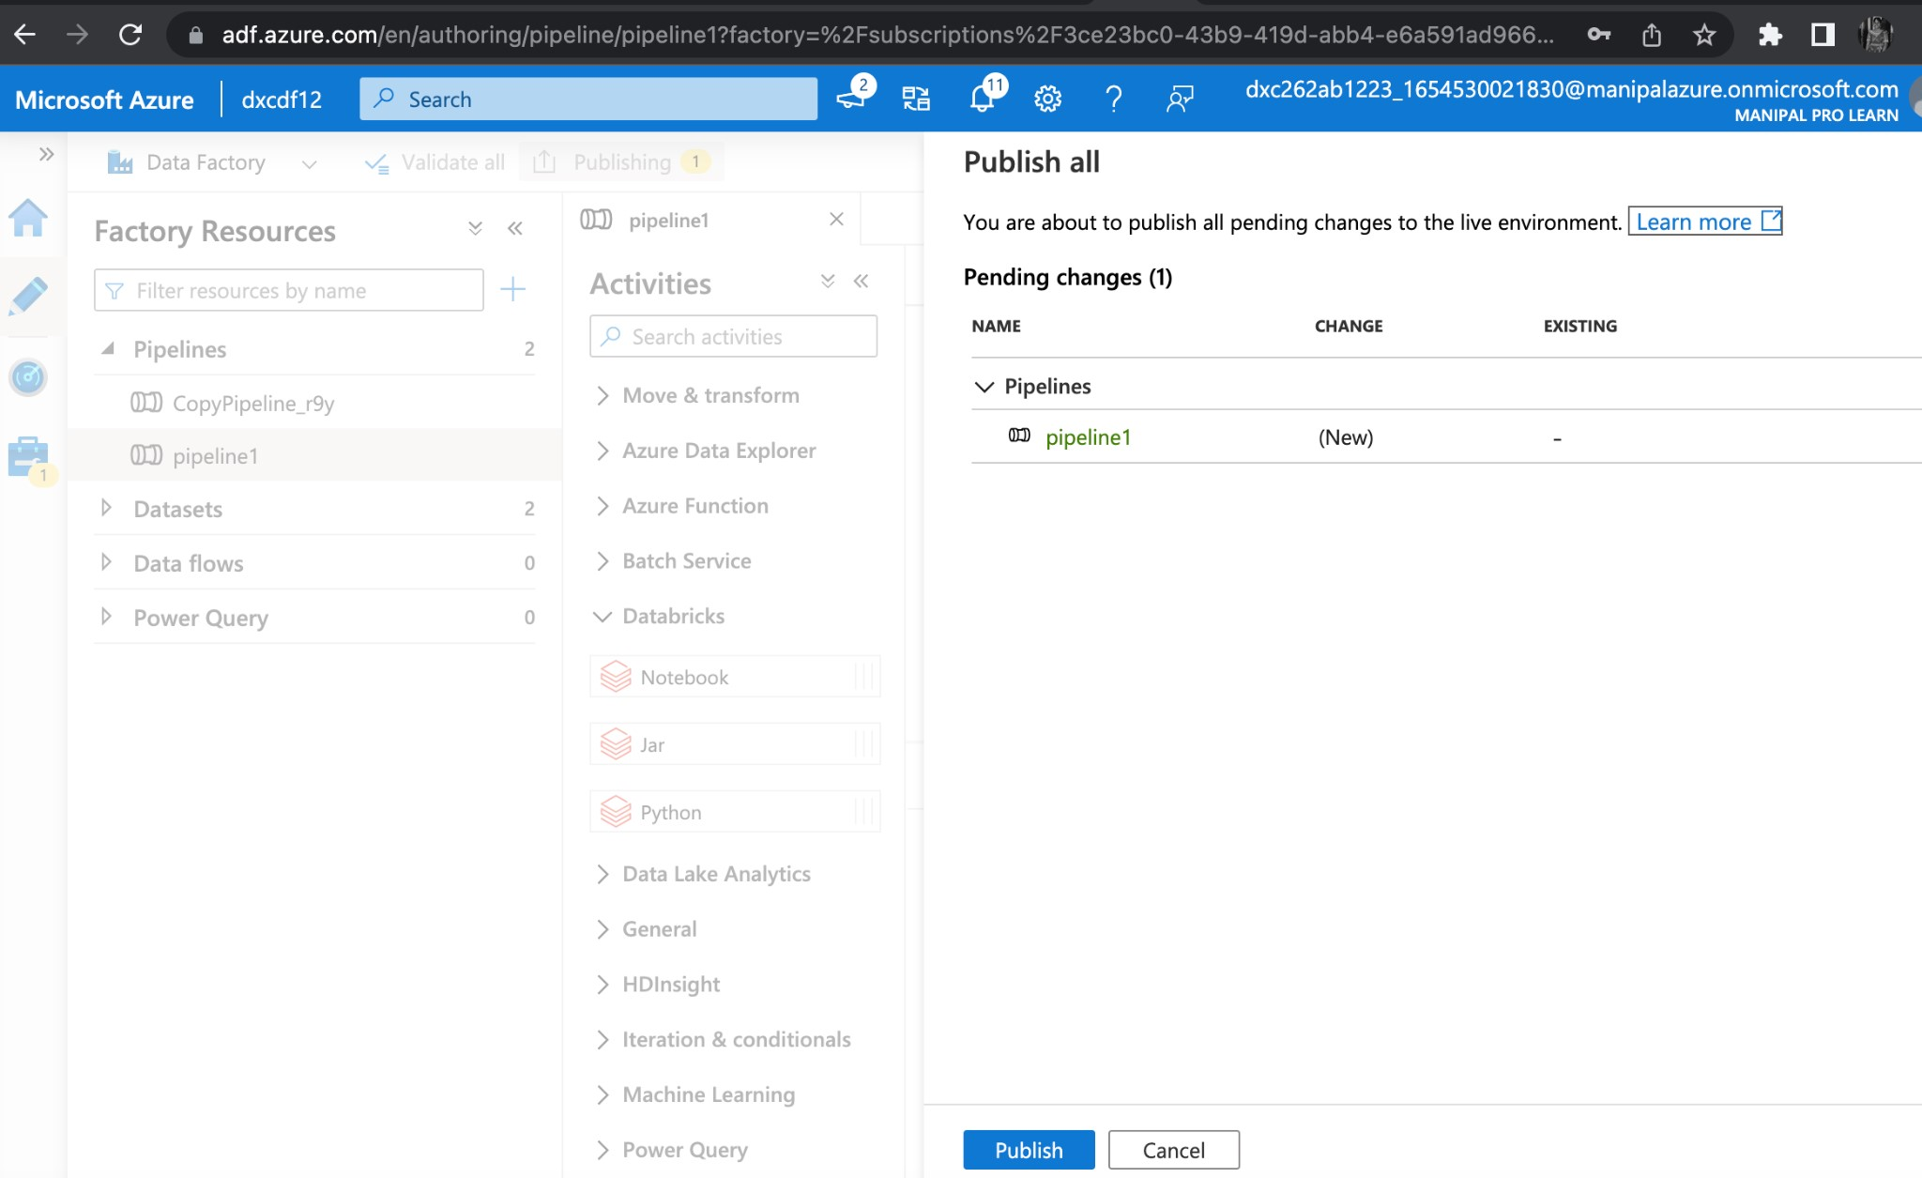
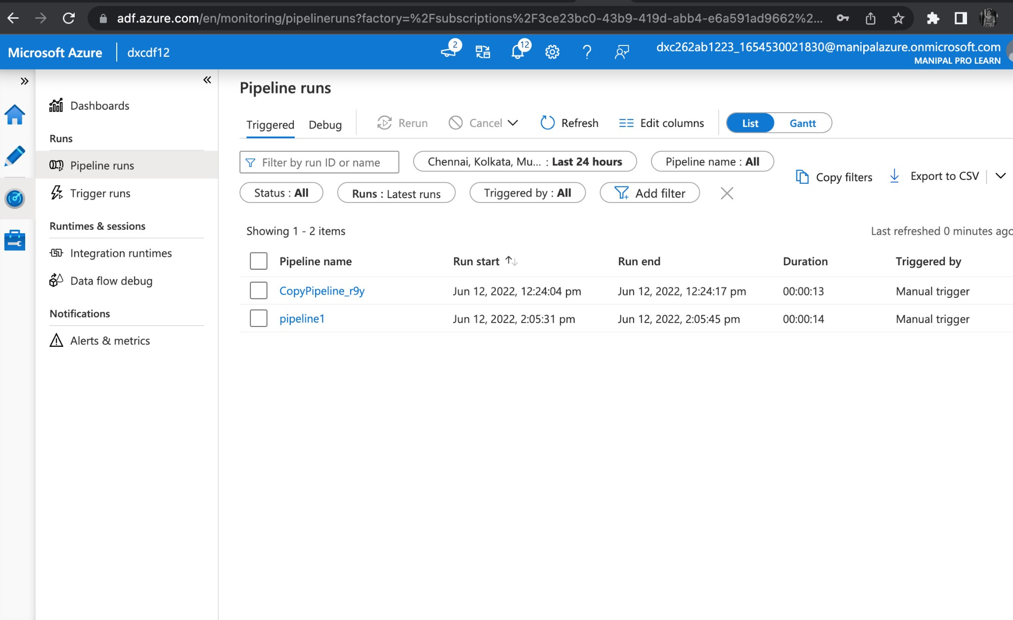
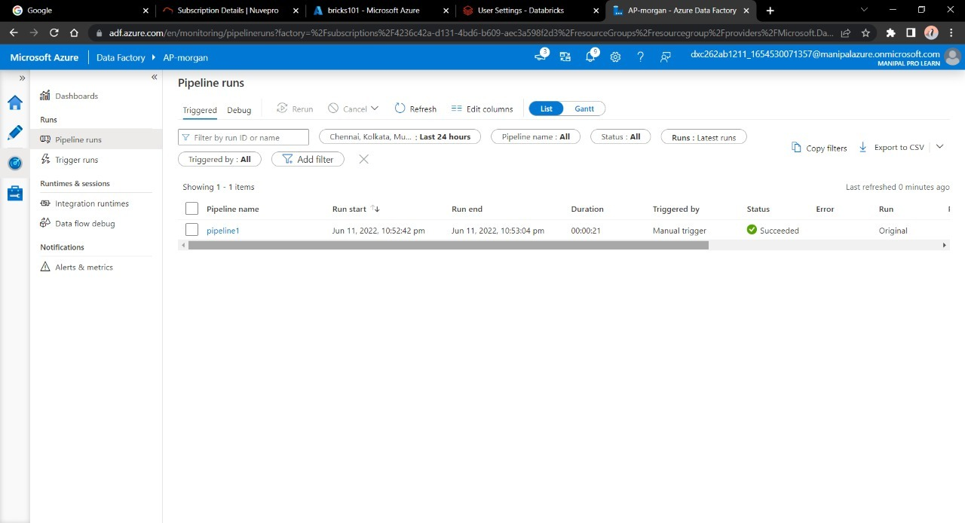

Slide 34
Conclusion:- We have successfully triggered a linked notebook from datafactory THANK YOU

